Slide 1
Lecture 3 – Interaction Fundamentals
Terry Winograd
CS147 - Introduction to Human-Computer Interaction Design
Computer Science Department
Stanford University
Autumn 2006

Slide 2
Learning Goals
Have an overview of the conceptual framework for HCI
Understand how the distinctions among utility, usability, and experience affect design priorities
Understand the conceptual interaction cycle, including issues of direct manipulation, inconsistent models, distance, and engagement

Slide 3
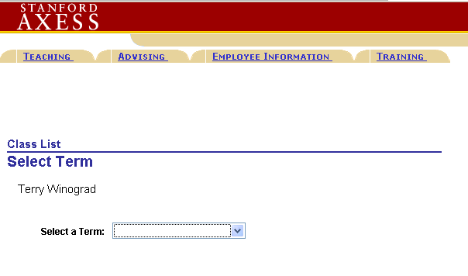
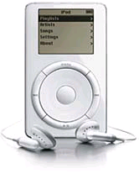
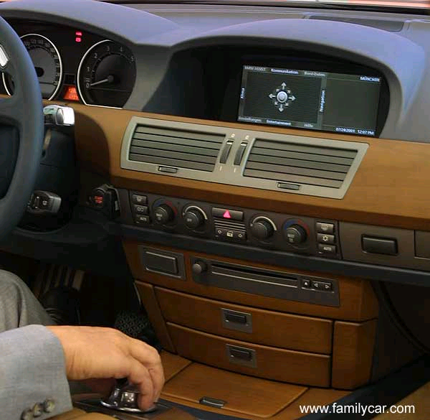
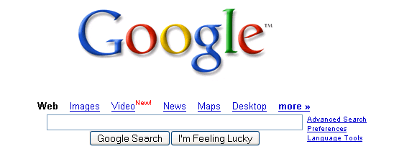
Good and Bad Interfaces

Slide 4
Going Beyond Common Sense
Conceptual tools
  Language for analysis
  Principles
  Standards
  Guidelines
Operational tools
  Systems and toolkits that embody concepts in use
Methods for analyzing designs and making tradeoffs

Slide 5
Basic Goals of Interaction Design
Utility
  Does it do something that fulfills a need or desire for some user group
Usability
  Can the intended users make effective use of its capabilities
Experience
  Does it create an enjoyable experience

Slide 6
Command-based interaction
login as: winograd
winograd@graphics's password:
Last login: Tue Sep 20 15:22:48 2005 from xtz.stanford.edu
***********************
* Welcome to SULinux! *
* Authorized Use Only *
***********************
Hint: run /usr/sbin/sulinux to reconfigure at any time
Graphics> echo "hello world"
hello world
Graphics> connect to the web
connect: Command not found.
Graphics> help
help: Command not found.
Graphics> rm –R *
Graphics>

Slide 7
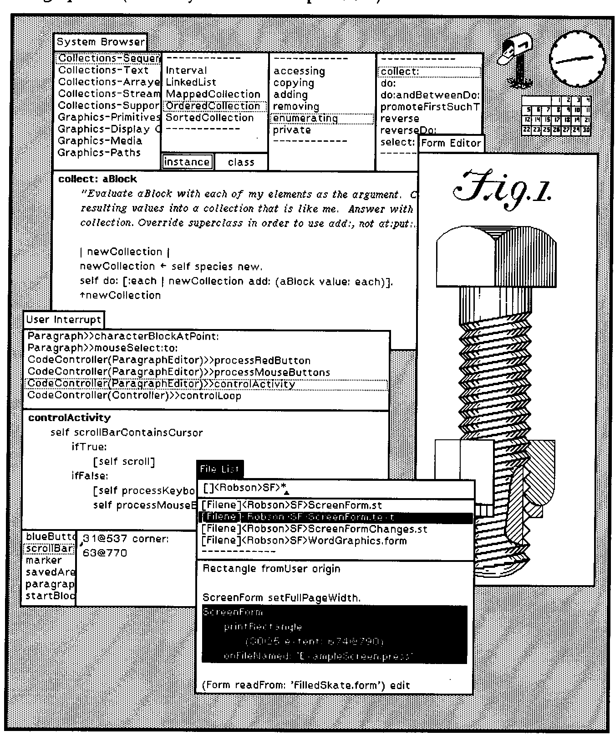
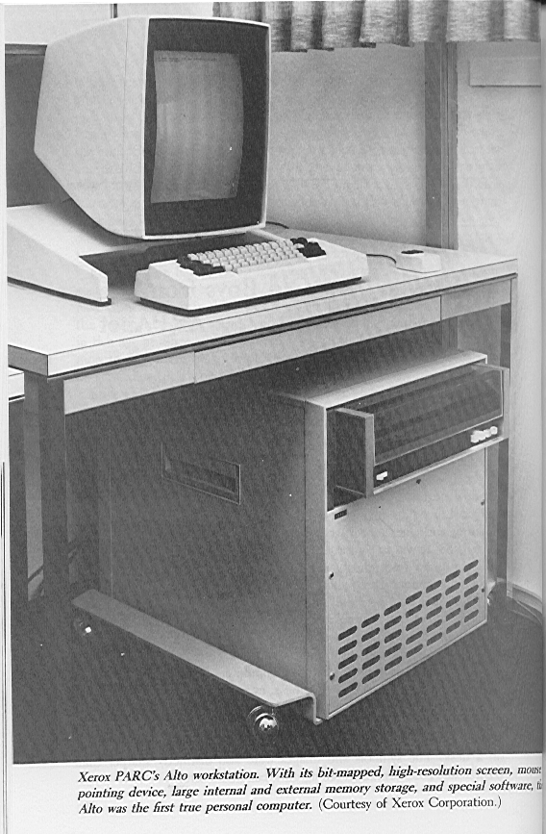
Direct Manipulation – Smalltalk on the Alto (1974)

Slide 8
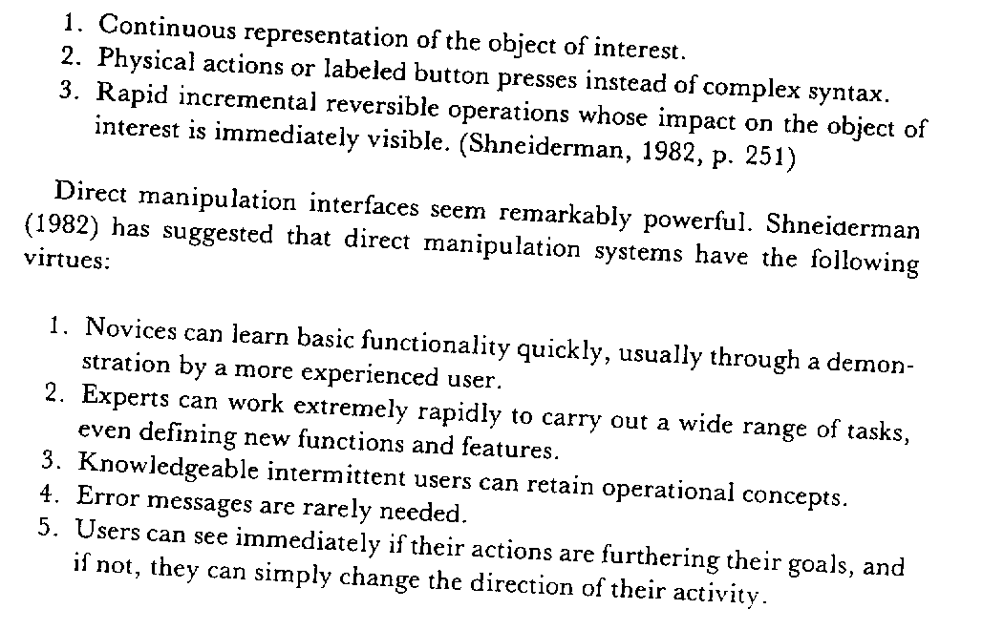

Direct Manipulation Interfaces
Ben Shneiderman, 1982

Slide 9
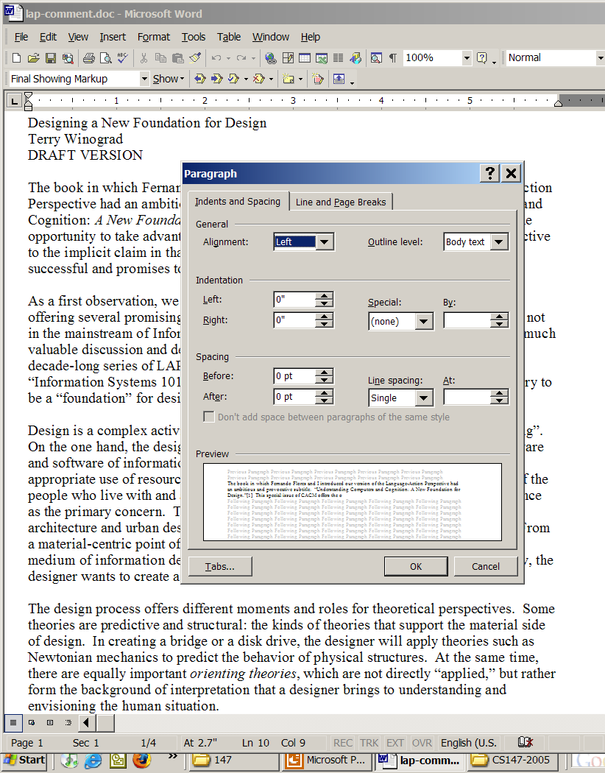
Direct and Indirect coexist

Slide 10
What is directness?
Directness is an impression or feeling about an interface
Directness is not a quality of the interface alone, but involves a relationship between the task that the user has in mind, and the way that task can be accomplished via the interface.
Directness is associated with lower cognitive load!
Notes:
distance: between user’s goals and how to specify them to system

Slide 11
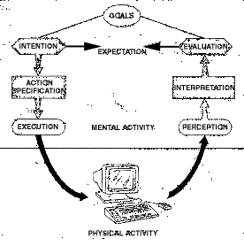
Seven Stages of Action

Slide 12
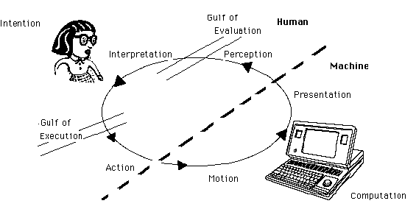
The Interaction Cycle

Slide 13
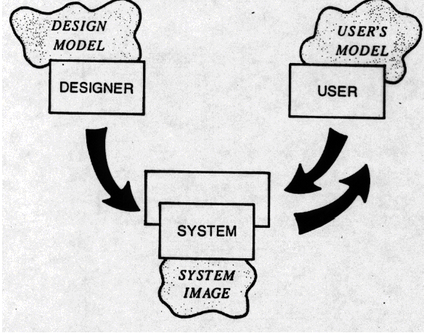
Conceptual Model of A System
Design Model
  The model the designer has of how the system works
User’s Model
  How the user understands how the system works
System Image
  How the system actually works
  The structure and behavior of the system
The most important thing to design is the user’s model. Everything else should be subordinated to making that model clear, obvious, and substantial. That is almost exactly the opposite of how most software is designed. David Liddle

Slide 14
The Gulfs - where thought is required
The gulf of evaluation is the thinking required to understand what is being perceived -- turning the raw sensory data into an understanding of objects, properties and events.
The gulf of execution is the thinking required to figure out how to get something done - turning the high-level intention into specific physical actions

Slide 15
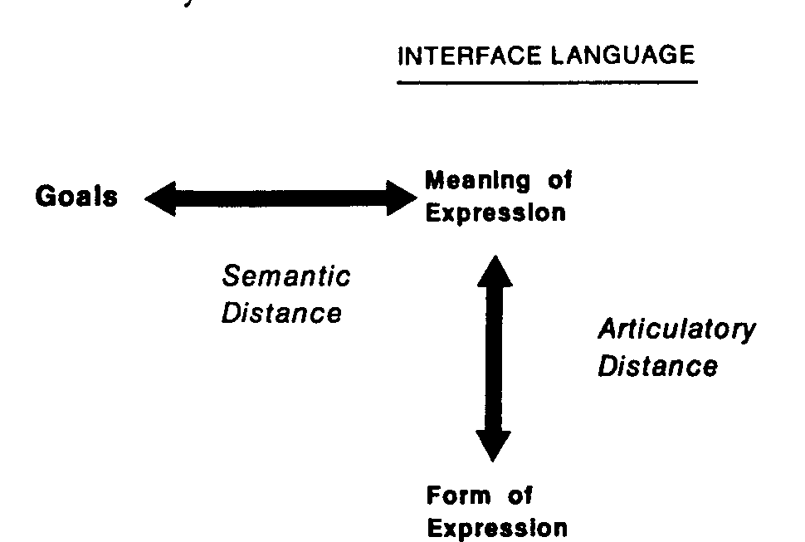
Distance - the measure of how big the gulf is
Semantic Distance
  relationship between intentions and meanings of expressions
Articulatory Distance
  relationship between the meanings of expressions and their physical form

Slide 16

Example – Moving an image on a page
“Nudge” Menu Item
(PowerPoint)
“Position Picture”
(Word)
Articulatory
Distance
Drag and Drop
(PowerPoint)
Insert spaces
(Word)
Semantic Distance
Notes:
- “dw” in vi for “delete word” is not direct even though you may do it automatically (just ask a newbie). automatization may feel like direct control, but gives the system credit for the user’s learning effort.
“grep the newspaper”
piano more direct for simple note production, but violin more direct to create subtle vibrato effects

Slide 17
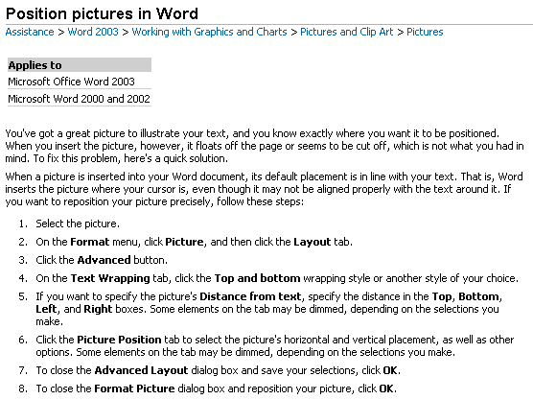

Slide 18
Engagement
the feeling of involvement directly with a world of objects, rather than of communicating through an intermediary
  In direct manipulation the user is engaged with the objects themselves (e.g., drawing elements)
  In a conversational system, the user is engaged in conversation with the system, which in turn acts on the objects of interest (e.g., giving a command line to move files)
Requires:
  Directness
  Compatible I/O languages
  Responsiveness, and
  Unobtrusiveness

Slide 19
Affordances
“...the perceived and actual properties of the thing, primarily those fundamental properties that determine just how the thing could possibly be used.” [Norman88]
“...affordances of the environment are what it offers the animal...” [Gibson77]
Notes:
design with labels is often bad design
generally true for sw UIs as well
exception: complex, abstract functions (no simple physical affordances possible)
Die Form eines Stuhls suggeriert, sich darauf zu setzen
Auch andere Aktionen sind möglich (hochheben, sich daraufstellen etc.)
Aber: Sie sind nicht die durch das Design naheliegendsten
Ein einfacher Stuhl ist intuitiv „benutzbar“
Keine Beschriftung nötig („Hier setzen“)

Slide 20
Perceived affordances - Visibility
Norman's work is primarily concerned with perceived affordances - what the user understands the affordances to be
The correct parts must be visible and they must convey the correct message
If you can't see it (or find it) you can't use it
Perceived affordance is a combination of what you see, and what you know

Slide 21
Natural mapping
What makes a design natural?
  taking advantage of physical analogies and cultural standards
  Physical properties (stove burner layout)
  Metaphorical/linguistic (on is up)
  Analogous function (playback control buttons)
  “Natural” is individual and culture-dependent

Slide 22
Constraints and Feedback - Avoiding error
Constraints: Physical, logical, and cultural
Interactivity - expectation of behavior
Modes and mixed expectations
Normal human error
  Error anticipation
  Error correction/compensation

Slide 23
Recap of the Concepts
Direct Manipulation
Gulfs
Distance [semantic and articulatory]
Engagement
Perceived affordances
Natural mappings
Constraints
Feedback
Avoiding error

Slide 24
How does the iPod stack up?
Direct Manipulation
Reducing Distance
Engagement
Perceived affordances
Natural mappings
Constraints
Feedback
Avoiding Error

Slide 25
Negative Examples
Bad human factors designs By Michael J. Darnell
The Interface Hall of Shame

